Slide 1

Hospital Patient Records Management System
A web-based application for patient records management.
Presented by Aditya Patil (21BIT0085) and Rupesh Dahibhate (21BIT0104).

Slide 2




Project Overview
Purpose
Efficiently manage patient data in hospitals.
Features
Patient Search
Add New Patient
View Patient List
Responsive Design
Technologies
HTML, CSS, JavaScript, AWS

Slide 3
System Workflow
Step 5
Step 3
For adding a patient, input necessary details and submit.
Step 1
For search, input criteria like name or illness.
User opens the app.
Step 2
Step 4
Step 6
Choose between searching or adding a patient.
Results are fetched from the backend and displayed.
Data is stored in AWS, and confirmation is shown.

Slide 4
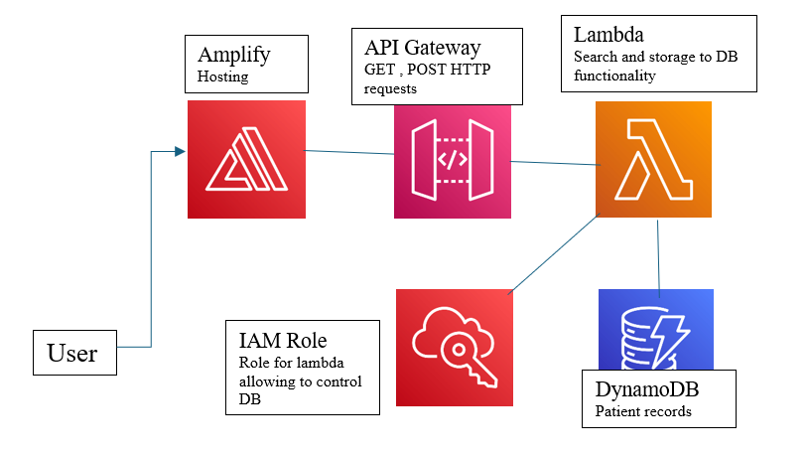
Architecture

Slide 5

Key Features of the System
Search Patients
Add New Patient
Allows users to search for patients by name or illness.
A form to enter new patient details like name, age, gender, and illness.
View Patients List
Responsive Design
A responsive table that lists all patients and their details.
Optimized for both desktop and mobile views.

Slide 6





AWS Services Used in the Project
AWS Amplify
AWS API Gateway
AWS Lambda Functions
AWS DynamoDB
A fully managed service for building and deploying web and mobile applications.
A fully managed service that acts as a front door for applications.
A fully managed, serverless NoSQL database service.
A serverless compute service that lets you run code without provisioning or managing servers.
IAM Role
IAM Role to manage permissions to DynamoDB.

Slide 7
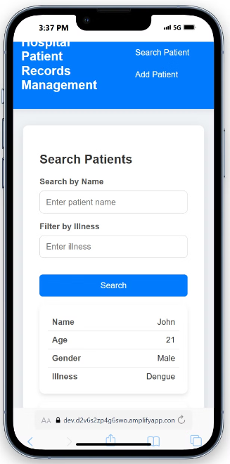
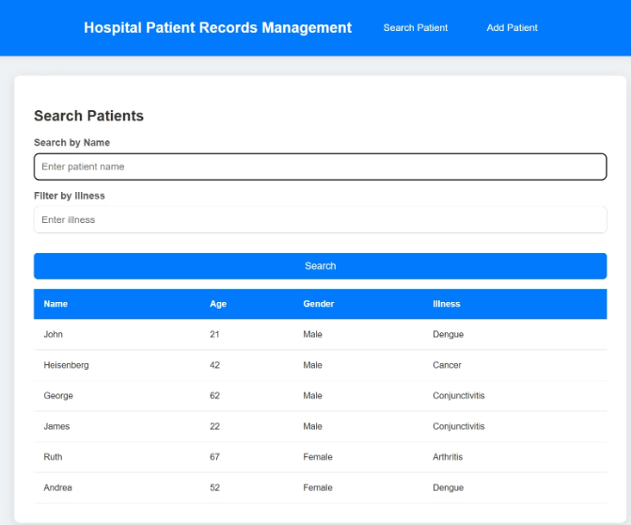
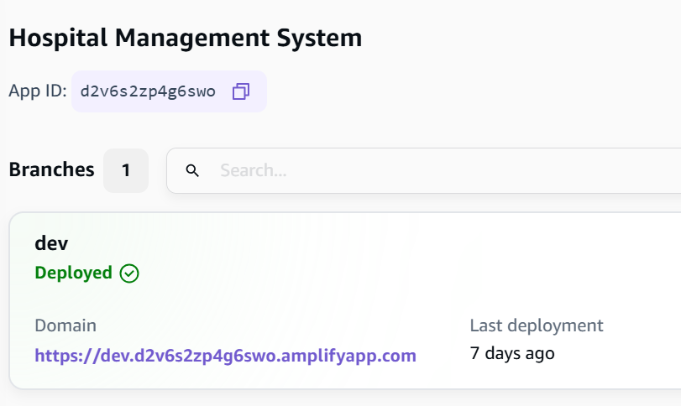
Responsive Design deployed on AWS Amplify
The frontend built using HTML, CSS and JS adapts to different screen sizes, providing an optimal user experience across devices.
On desktop devices, patient data is displayed in a traditional table format.
On mobile devices, the table data is displayed as block elements with labels for easy readability.

Slide 8

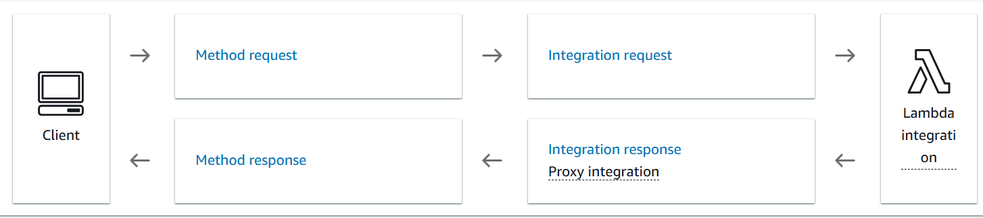
AWS API Gateway
1
Functionality
2
Usage
3
Benefits
Manages all incoming HTTP requests from the frontend.
Receives requests for adding and searching patients.
Provides scalability and security for managing API endpoints.

Slide 9


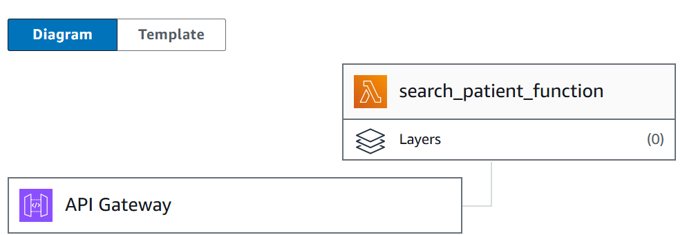
AWS Lambda Functions
Serverless Architecture
Business Logic
Cost-Effective
Lambda functions scale automatically with request load, ensuring optimal performance.
Lambda functions handle the core business logic of the application, such as searching for patients and adding new patients.
Lambda functions are pay-per-use, making them a cost-effective solution for managing serverless workloads.

Slide 10

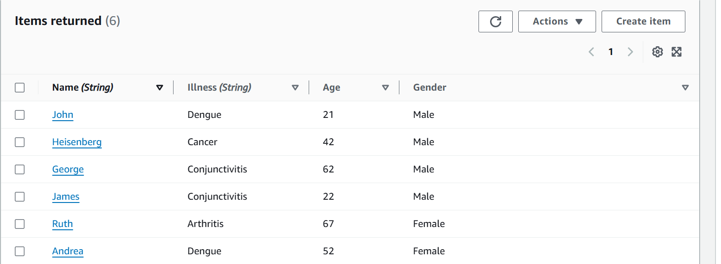
AWS DynamoDB
Functionality
Usage
NoSQL database for storing patient data.
Stores patient details like name, age, illness, and treatment history.
Benefits
Scalable and high-performance database. Fully managed with low-latency read and write operations.

Slide 11


AWS IAM (Identity & Access Management)
Secure Access Control
IAM Role
IAM defines who can access AWS services, ensuring only authorized entities can interact with critical resources.
The Lambda functions are given a role to allow modifications of the DynamoDB

Slide 12




Challenges & Solutions
Data Security
IAM roles and policies ensure secure access to sensitive data.
Responsive Design
Media queries adapt the layout for different screen sizes.
Real-Time Data
AWS Lambda and API Gateway handle dynamic data processing efficiently.

Slide 13




Future Scope
Implement authentication to secure patient data.
Add more filters, like age and gender.
Create a detailed dashboard for each patient.

Slide 14

Conclusion
1
Key Features
2
Scalable and Secure
3
Responsive Design
The Hospital Management System offers essential features for managing patient data, including search, add, and view functions.
The system leverages AWS for a robust and secure backend, ensuring scalability for future growth.
The system is designed to be responsive, providing an optimal user experience across all devices.

